Slide 1





TGNAS Enterprise
Accurate Service Locator
ASL
www.shorturl.at/lcCjM

Slide 2





Why I have started this project
The Gap In the Market
My Own Personal Experience
Collaboration
Experience
Let me Share a Personal Experience of mine, when I went to kolli hills with my family, as I am a pure vegetarian I couldn’t find a single good hotel/mess in google maps
This gap presents a unique opportunity to introduce a product that addresses the specific needs of this overlooked segment
By working together, we create opportunities for mutual growth and success, benefiting all parties involved.
I thought that the experience that I get from working on this project is nothing compared to countless tutorials

Slide 3




MISSION AND GOALS
01
Capable of highlighting every small store and stall
02
Our service simplifies the process for customers to locate and identify the best shop that meets their needs.
03
Boost the revenue of small-scaled shops and stalls

Slide 4
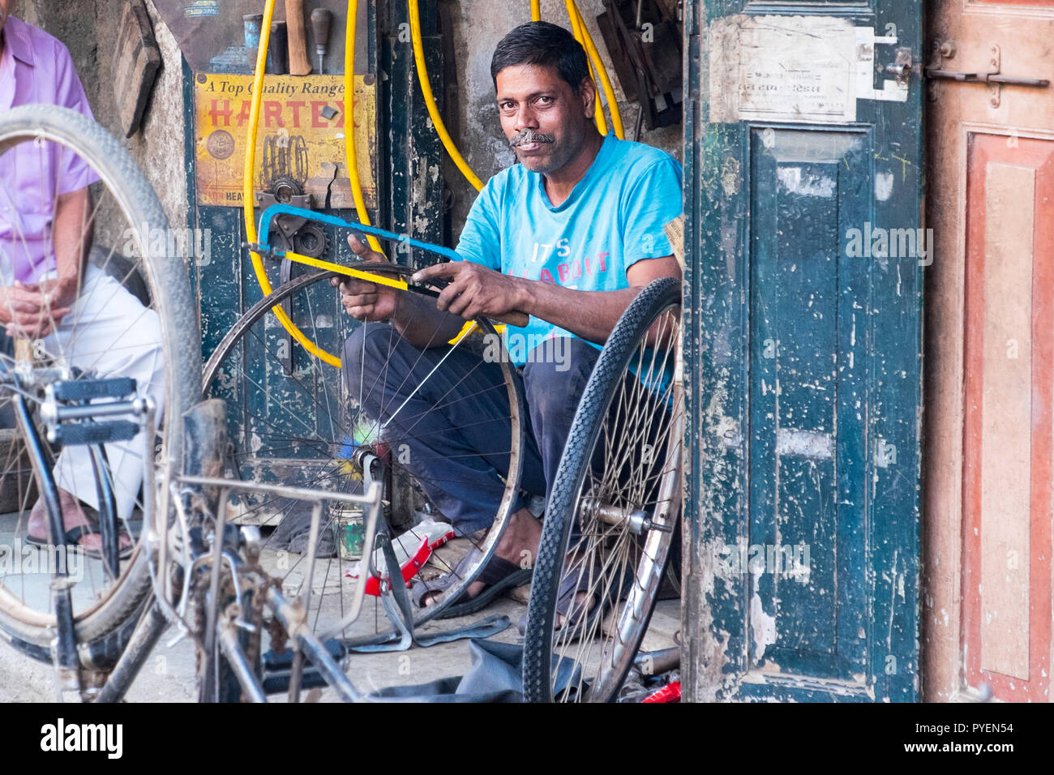
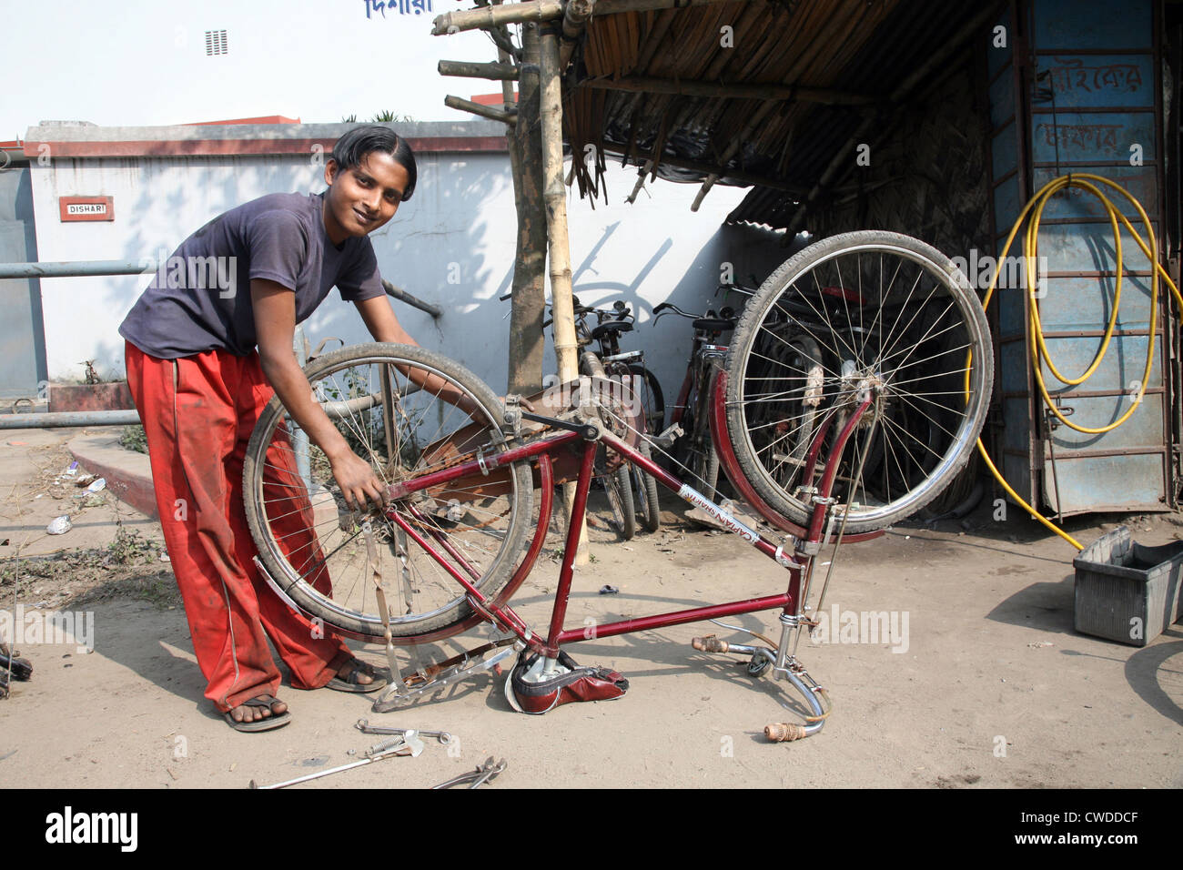
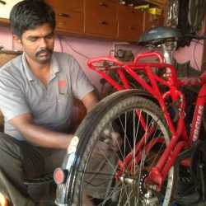

STATISTICS
How we can achieve This target
Assume that we have about 1000 monthly users across the platform, a cycle mechanic approx. Revive its customers 15 to 20 per day at peak time if one customer pays average amount of 100rs then the mechanic earns approx. Of 150 to 200 rs per day with the help of this platform mechanic can earn more customers, we can assume that it lies between 25 to 30 he can earn upto 250rs to 300rs.
Advertisement in Social media
Paid promotion in social media
Banner Ads in app and games
36%
INCREASE IN REVENUE

Slide 5




Client Side Features
Owner and Worker Details
Timing Of the Shop
Contact Information
Ability to Chat Via App to the Shop owner
Ability to Rate or Report a Shop
Ability to search a product using camera or images
Ability to Book an appointment
Freedom to find The their Needs in a unknown or remote locations

Slide 6

Vendor Side Features
Vendors must verify their identity using a government issued ID like Aadhar, PAN.
Vendors can get More customers
Every chat and transaction is recorded so no fear of scam
Ability to Chat Via App to the Customer
Ability to Report a Customer
Ability to upload a image of the project or service they selling
Ability to accept an appointment and work later
Ability to improve their revenue by advertising their shops in local

Slide 7






Additional Features
01
02
Communities
Advertise
Communities are the heart and soul of our shared experiences. They provide a sense of belonging, support, and mutual growth. By coming together, individuals can pool their resources,
Vendors can advertise their services and products in the app so that they get more attention compared to others
03
04
05
TGNAS
Sell and Buy
Works Offline
Cross Platform
Vendor can buy and sell their products through online with safe and secure as every transactions are recorded
Capable of working offline so that even in a no internet zone or in a very remote location [ needs to download specific app ]
The application can be developed in android,ios,windows ,macOS and Linux so that every one has equal access

Slide 8




PROJECT PROTOTYPE
https://www.figma.com/proto/Y90YRIhbp5yVpV7zxIoWDj/Untitled?node-id=1-2&node-type=canvas&t=PoWGfAi89bw9gEdY-1&scaling=scale-down&content-scaling=fixed&page-id=0%3A1&starting-point-node-id=1%3A2
Presentation and Sharing
Review and Editing
Project Initiation

Slide 9

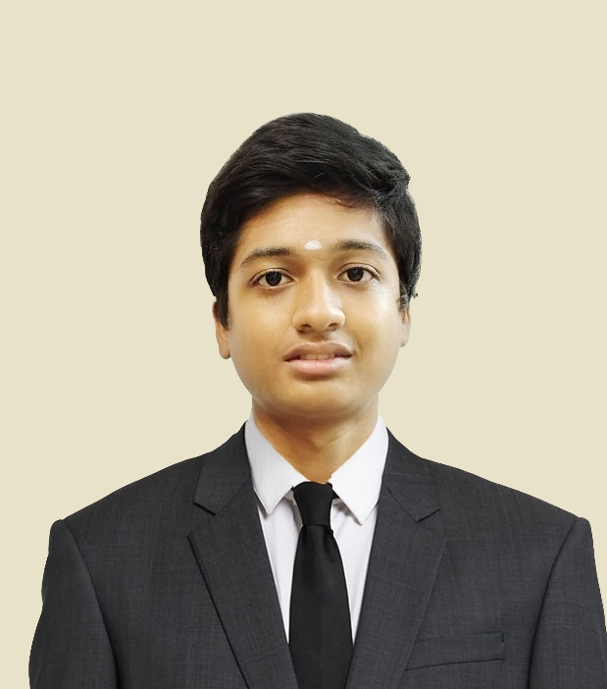



OUR TEAM
N. Akshay Srinivas
Sri Ramakrishna Institute of Technology
+919003914126
www.linkedin.com/in/akshay-srinivas-047b2a328/
Sree Daksha,Vadavalli

Slide 10






TGNAS Enterprise
THANKS FOR WATCHING

